Slide 1



BULE HORA UNIVERSITY
COLLEGE OF COMPUTING AND INFORMATICS
DEPARTMENT OF SOFTWARE ENGINEERING
ORGANIZATION: GUBA LAFTO CONSULTING ARCHITECTS AND ENGINEERS PLC (GCAE)
ACADEMIC ADVISORS: MR. MIHIRETU & MR. DEGAGA
COMPANY ADVISOR : MR. HABTAMU (IT DIRECTOR, GCAE)
INTERNSHIP DURATION: JUNE 27, 2025 – OCTOBER 10, 2025
PREPARED BY:
NANBON BEKELE

Slide 2

Contents
Introductions
Internship Organization
Internship Objectives
Role and Assigned Tasks
Methodology
Achievements
Challenges Faced
Lessons Learned
Recommendations
Conclusion
References

Slide 3


ABOUT US
Who We Are
4th-year Software Engineering students with a passion for innovative web development.
Combined academic knowledge with real-world application during our internship.
Worked as a collaborative team to design and implement Vision Hub for Gubalafto Consulting Architects & Engineers PLC (GCAE).

Slide 4

Academic Background
Completed core courses:
Software Engineering Methodologies
Database Systems
Web Programming
System Analysis & Design
Applied these skills directly in the Vision Hub project.

Slide 5
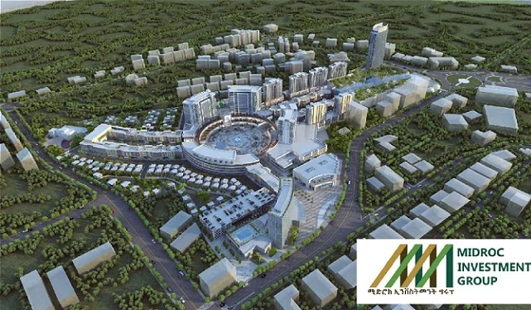
Internship Organization
Guba Lafto Consulting Architects & Engineers PLC (GCAE)
Type: Private consulting firm under the MIDROC Group.
Industry Sector: Architecture and Engineering, ICT, Electro-Mechanical and Material Testing.
Mission: To provide high-quality consultancy services, adhering to international codes and standards, with a focus on data security and integrity.
Vision: To become a leading architectural and engineering consultancy firm in East Africa.

Slide 6
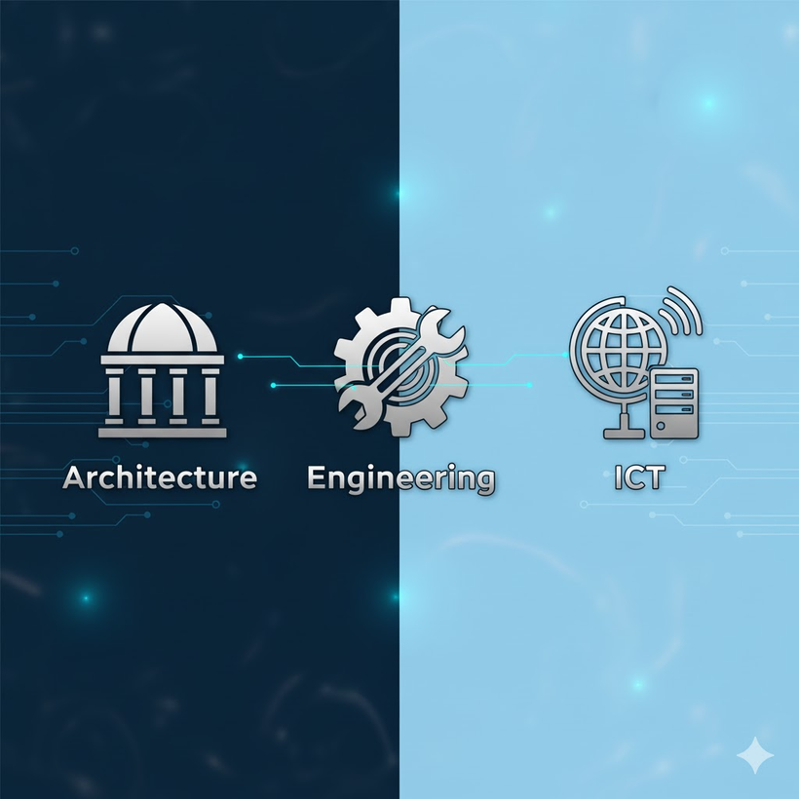
Organizational Structure Overview
Gubalafto Consulting Architects and Engineers PLC (GCAE)
Member of MIDROC Investment Group
Headed by a General Manager
Organized into four main directorates:
Design & Supervision
Electro-Mechanical
ICT Services
HR, Purchasing, Property & Finance
Key Departments & Roles
Architectural and Engineering Design Services: Full project design (Architectural & Structural).
Electro-Mechanical Engineering Services: MEP Systems design and consultation.
ICT Services: Digital infrastructure and software support.
Material Testing and Inspection Service: Material quality testing and inspection.

Slide 7
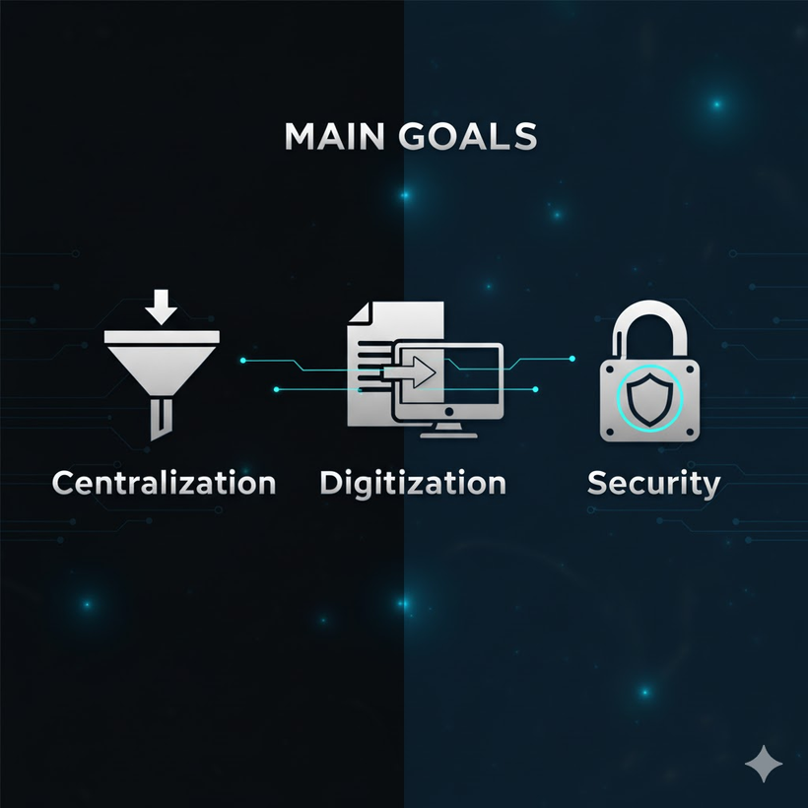
INTERNSHIP OBJECTIVES
Main Goals of the Internship
1
Design, develop, and deploy Vision Hub, a centralized web portal for GCAE.
Automate and streamline workflows for HR, clients, and administrative tasks.
Improve organizational transparency, coordination, and data accuracy.
2
Personal Learning Objectives
Apply academic knowledge to real-world software engineering projects.
Gain experience in full-stack web development and cloud technologies.
Enhance teamwork, communication, and project management skills.
3
Skills Intended to Gain
Technical: React, TypeScript, Tailwind CSS, Supabase (Postgres, Edge Functions)
Professional: Agile workflow, requirement analysis, system design, testing
Soft skills: Collaboration, problem-solving, time management

Slide 8
Internship Role / Assigned Tasks
Role During Internship
Full-Stack Developer Intern
Our team is responsible for developing Vision Hub.
Assigned Tasks / Projects
Analyze GCAE’s existing manual workflows.
Interviewed stakeholders and documented all functional requirements for the system
Design and implement a centralized web portal for HR, clients, and administration.
Develop role-based dashboards for employees, HR, department heads, and clients.
Implement authentication, scheduling.
Conduct testing, debugging, and system evaluation.
Tools / Software / Technologies Used
Frontend: React, TypeScript, Tailwind CSS, shadcn/ui, Vite
Backend: Supabase (PostgreSQL, Edge Functions, Storage)
Other Tools: VS Code, Postman, Lucide-react icons,
Running Environment: node.js and docker desktop

Slide 9
Methodology / Work Process
Step-by-Step Approach
1
Requirement Gathering
Conducted structured interviews with HR and admin staff.
Reviewed existing documents and email workflows.
Observed ongoing processes to identify inefficiencies.
2
System Analysis & Design
Analyzed the existing fragmented system.
Designed architecture, activity diagrams, and class diagrams.
3
Development & Implementation
Built frontend using React, TypeScript, and Tailwind CSS.
Developed backend with Supabase (Postgres, Edge Functions, Storage).
Implemented role-based dashboards and secure authentication.
Testing & Evaluation
Conducted unit testing, integration testing, and user acceptance testing (UAT).
Gathered feedback from HR and management teams.
4
5
Deployment & Documentation
Prepared final system deployment and user manuals.
Documented project lifecycle and implementation details.

Slide 10
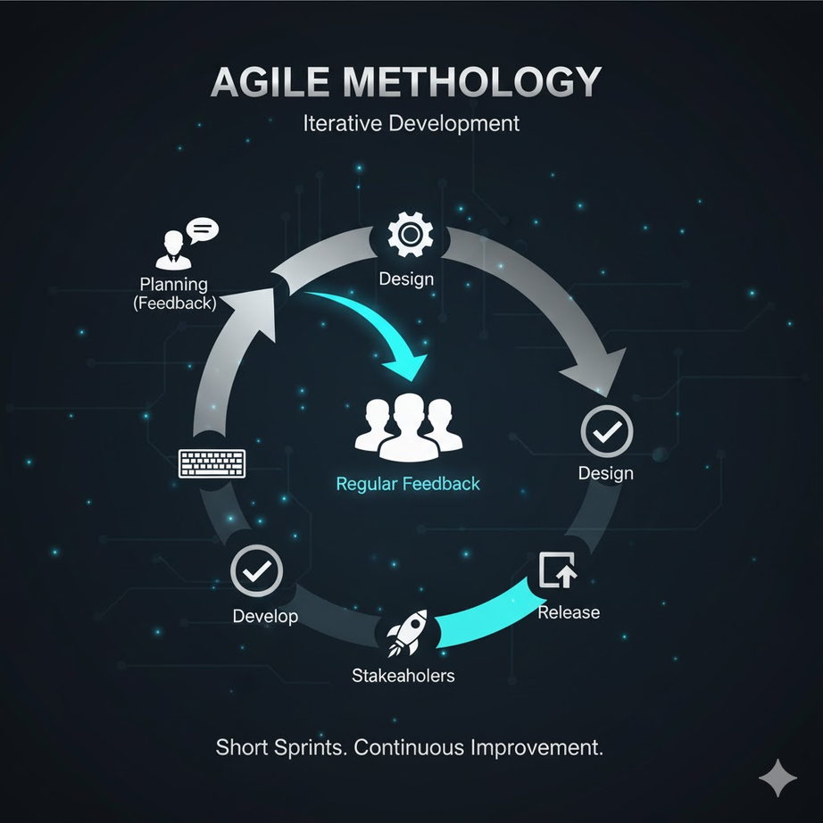
Work Methods / Frameworks
Agile Methodology: Iterative development with regular stakeholder feedback.
UML Diagrams: Activity, class, and deployment diagrams to guide system design.
Component-Based Development: For reusable frontend modules.

Slide 11
Achievements / Contributions
Key Accomplishments
Successfully developed a fully functional Vision Hub web portal centralizing HR, client, and administrative workflows.
Implemented role-based dashboards for different users: HR staff, employees, department heads, clients, and administrators.
Ease the workflows including recruitment, client service requests, staff management, and departmental coordination.
Ensured data integrity and centralized storage, replacing fragmented email and spreadsheet systems.
Skills Developed
Technical: Full-stack development, Supabase Edge Functions, React, TypeScript, Tailwind CSS.
Professional: Agile workflow, system analysis, documentation, collaborative coding.
Soft Skills: Teamwork, communication, problem-solving, time management.
Positive Impact on the Organization
Streamlined HR and departmental operations.
Improved transparency and accountability with digital dashboards.
Facilitated better client interaction and service request management.
Provided a scalable platform for future digital transformation initiatives.

Slide 12
Challenges Faced
Major Difficulties / Obstacles
Fragmented existing workflows: Hard to consolidate scattered email and spreadsheet data.
Learning curve: Familiarizing with Supabase Edge Functions and advanced React/TypeScript patterns.
Scheduling conflicts: Aligning team tasks and coordinating with HR for live testing.
Technical issues: Database migration, authentication configuration, and cross-origin requests.
How We Overcame Them
Conducted detailed requirement analysis and documentation to fully understand existing processes.
Studied official Supabase and React documentation and applied practical examples.
Adopted Agile workflow with daily stand-ups to coordinate team tasks.
Used testing and debugging tools (Postman, browser dev tools) to resolve technical challenges.
Engaged mentors and supervisors for guidance on complex issues.

Slide 13
Lessons Learned
1
Technical Skills Gained
Full-stack web development with React and TypeScript.
Backend development using Supabase (PostgreSQL, Edge Functions, Storage).
Database design, authentication, and secure role-based access control (RBAC).
UI/UX design using Tailwind CSS and component-based development.
Testing methodologies: unit, integration, and UAT.
2
Soft Skills Learned
Teamwork and collaborative problem-solving in a group project setting.
Communication with stakeholders and supervisors for requirement gathering.
Time management, task prioritization, and Agile workflow practices.
Professional documentation and presentation skills.
3
Industry Insights
Importance of digital transformation in improving organizational efficiency.
Real-world challenges in centralizing fragmented workflows.
Practical exposure to modern cloud-based serverless architectures.
Understanding security, scalability, and maintainability considerations in enterprise systems.

Slide 14
System Requirements
1. Functional Requirements.
User Authentication and Access Control
Client Functionalities
HR Staff Functionalities
Department Head Functionalities
Employee Functionalities
Marketing Communications Functionalities
Reporting and Dashboard
Database and Data Management

Slide 15
2. Non-Functional Requirements
Performance
Security
Usability
Reliability and Availability
Scalability
Maintainability
Portability

Slide 16
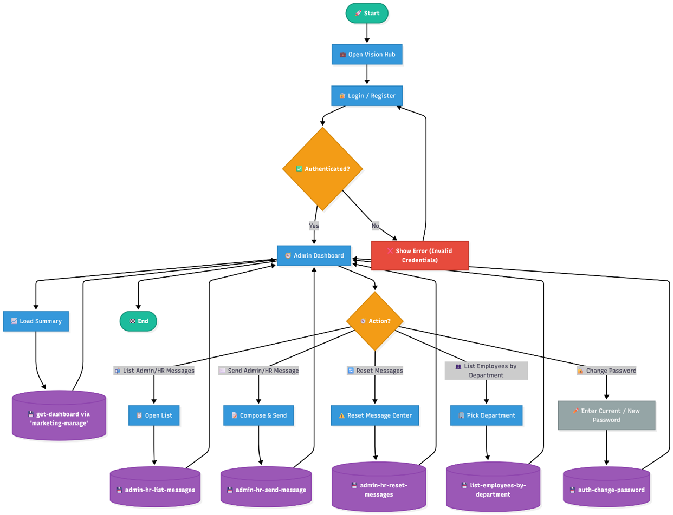

System Architecture (UML Diagrams)
Admin side activity diagram.

Slide 17
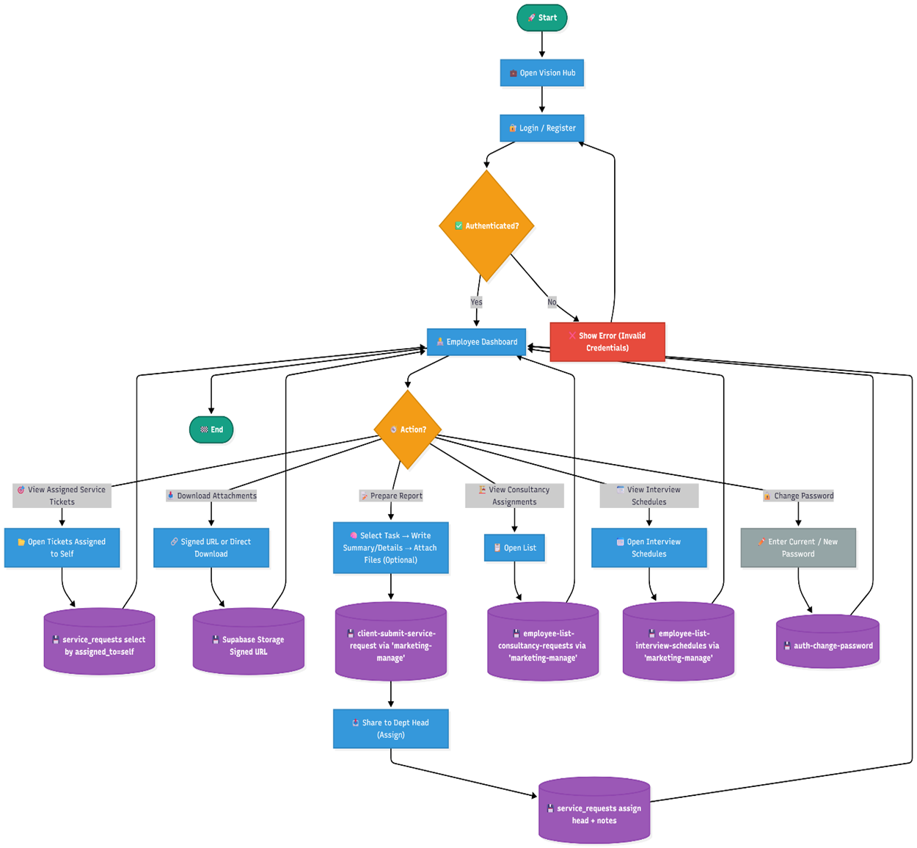
Employee Side Activity Diagram

Slide 18
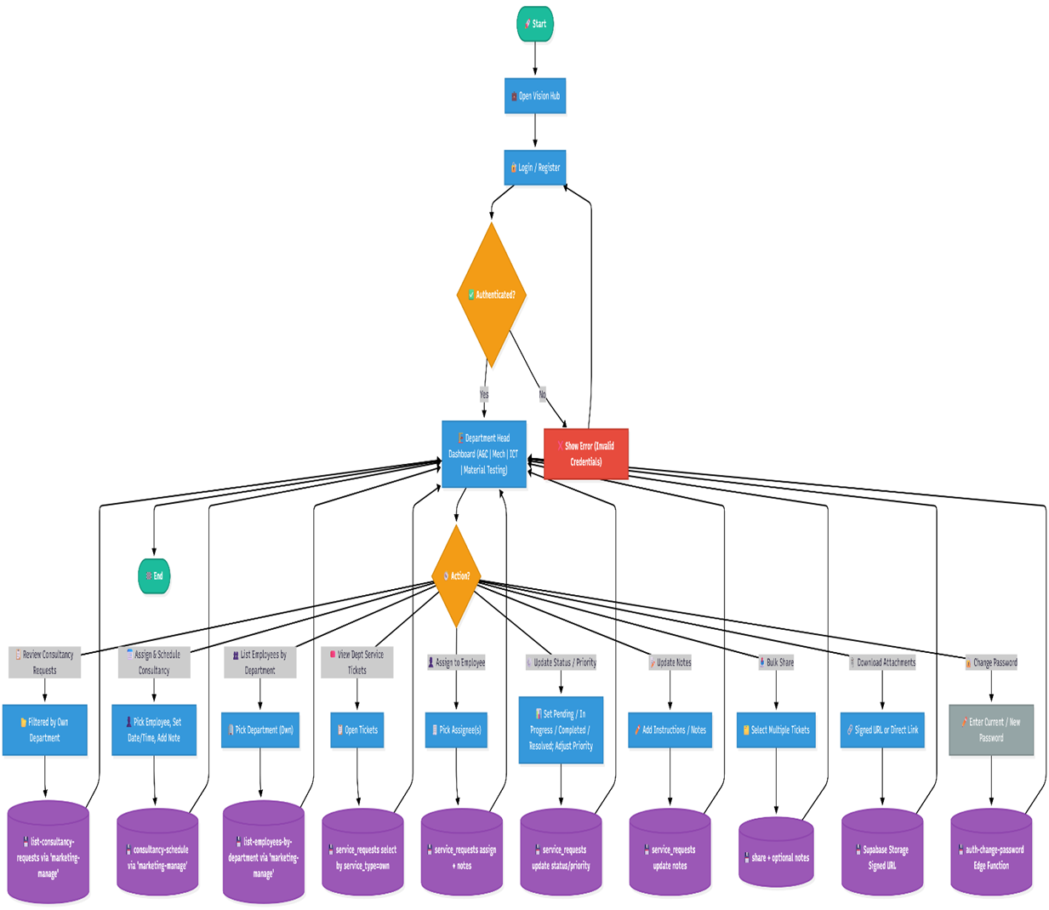
Departments Head Side Activity Diagram

Slide 19
Recommendations / Suggestions
Integrate system-wide activity logging for improved auditing and accountability..
Optimize the interface for mobile devices or develop a lightweight mobile app.
Regular backup and maintenance
Expand integration and automation capability
Implement AI powered analytic and reporting
Advice for Future Interns
Familiarize yourself with full-stack development technologies: React, TypeScript, Supabase.
Understand role-based access control and secure web development practices.
Prioritize communication and teamwork for successful project completion.
Document all workflows, challenges, and solutions throughout the internship.
Take initiative to learn new tools and frameworks that improve productivity.

Slide 20
References / Acknowledgments
Acknowledgments
University Advisor: Mr. Mihiretu and Mr. Degaga – for academic guidance and support.
Company Supervisor: Mr. Habtamu (ICT Director, GCAE) – for mentorship, feedback, and project supervision.
Organization Staff: HR and departmental teams at GCAE – for cooperation and insights.
Family & Friends: For encouragement and support throughout the internship.
References
Gubalafto Consulting Architects & Engineers PLC (GCAE) – Context Manual (GCAE/SOM/001).
Supabase Official Documentation: https://supabase.com/docs
React Official Documentation: https://react.dev
Tailwind CSS Official Documentation: https://tailwindcss.com/docs

Slide 21
Conclusion
Summary of Overall Experience
Successfully designed Vision Hub, centralizing workflows for GCAE.
Gained practical experience in full-stack web development and serverless technologies.
Learned to collaborate effectively in a team and interact with real-world stakeholders.
Overcame challenges in database migration, authentication, and system integration.
Contribution to Career Goals
Strengthened technical skills applicable to enterprise software development.
Developed soft skills including teamwork, communication, and problem-solving.
Gained insight into industry best practices, digital transformation, and scalable system design.
Prepared for future professional roles in software engineering and IT consultancy.

Slide 22

THANK YOU
THANK YOU FOR YOUR ATTENTION!

